Slide 1
Quantum Lecture 5.8
Time Evolution
Two Qubits
And
Tensor products
A⊗B

Slide 2
Agenda for Lecture 3
8:30 – 9:00 RECAP Status of Reports
9:15 – 10:00 Video 5.1 Rotation Matrix
10:15 – 11:00 Video 5.2 Unitary Transform
11:00 – 11:45 Video 5.3,4 ”Single Qubit Gates” and ”Two Qubits and Tensor products”
11:45 – 12:30 Lunch
12:30 – 13:15 Free according to last lect.
13:30 – 14:00 Free according to last lect.

Slide 3
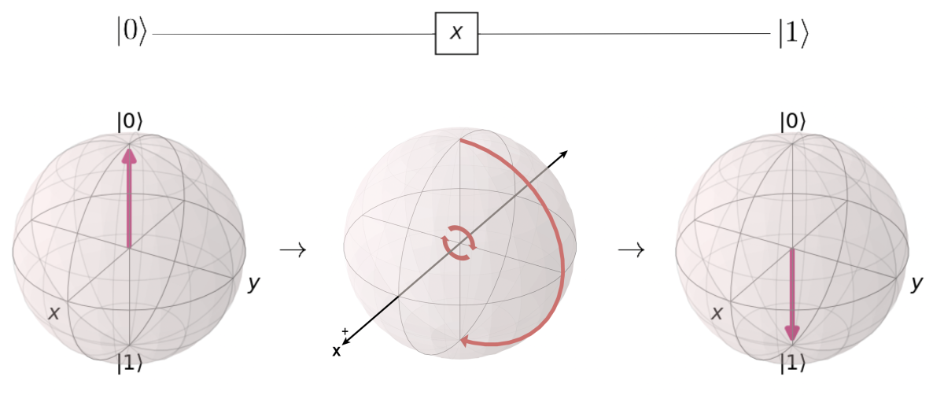
Exercise recaps
What is measurement about
What does the X,Y and Z do as OPERATORS

Slide 4
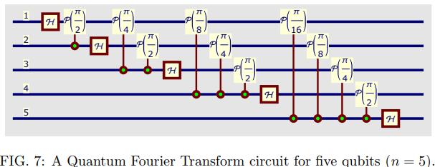
13:30 – 14:00 Coderanch
Try it out - RSA with 5 bit factorization

Slide 5
8:30 – 9:00 RECAP
Your Report of Your Own choice Status
Your CHSH Report Status
Your Qiskit Teleportation from last lecture ?
Please describe the most simple difference between an Inner products vs Outer product
Questions so far including the Mandatory Exercise at DTU
During the Gates video remember how You can combine gates

Slide 6
9:15 – 11:45 4 Videos
The Main topic of today is clearly to understand the meaning and power of a Tensor product on two Qubits
We are in general running through the 4 Videos and disquss the content and maybe find some Qiskit samples as examples as time goes by

Slide 7
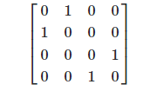
Transform matrix into a combination of simple quantum gates
I am trying to transform this matrix into a combination of quantum gates but I cannot find any such functionality on Qiskit or anywhere else. I have tried to use Quirk but I do not understand it.
quantum-gate qiskit gate-synthesis

Slide 8
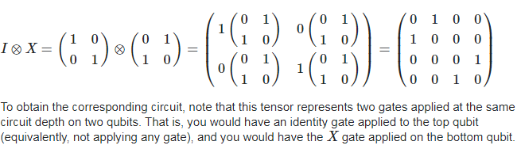
Matrix Con’t
If you are familiar with tensor products, observe that I⊗XI⊗X gives the desired matrix. Showing the steps of this computation,

Slide 9
Exercise in Tensor product A⊗B
Evaluate or find a qiskit sample that makes a Tensor product of two Pauli gates and shows the result.
Then Try to decompose above to get to the place where You started with two gates
Start with I⊗X
Then Z⊗X, Y⊗X , H⊗X and H⊗CNOT
Try to decompose an entangled state of a Hadamard and CNOT gate like , H⊗CNOT
What happens or maybe Shit happens !!

Slide 10
11:45 – 12:30 Lunch &/or Free for the rest of the day

